Slide 1
Exercise 7
Seed Plant Diversity

Slide 2
Labs 6 and 7 follow the evolutionary relationships among members of the Plant Kingdom, including their algal relatives. Lab 7 examines the plants that produce seeds. You should be able to classify these specimens into their respective phyla. As you look at these specimens and identify their parts, keep in mind the basic pattern of the alternation of generations and the changes that have occurred to allow plants to live on land. For example, in addition to identifying structure and function, ask yourself questions such as, "Is this structure part of a sporophyte or a gametophyte?“, “Are the cells haploid or diploid?” and "Are any of these structures adaptations to living on land?"

Slide 3
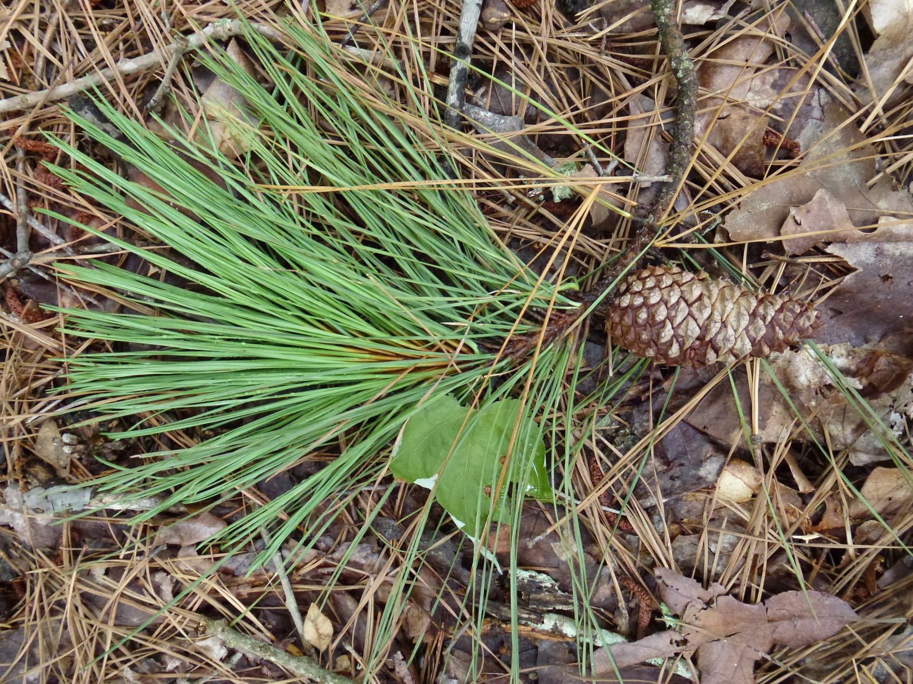
Pine Branch

Slide 4
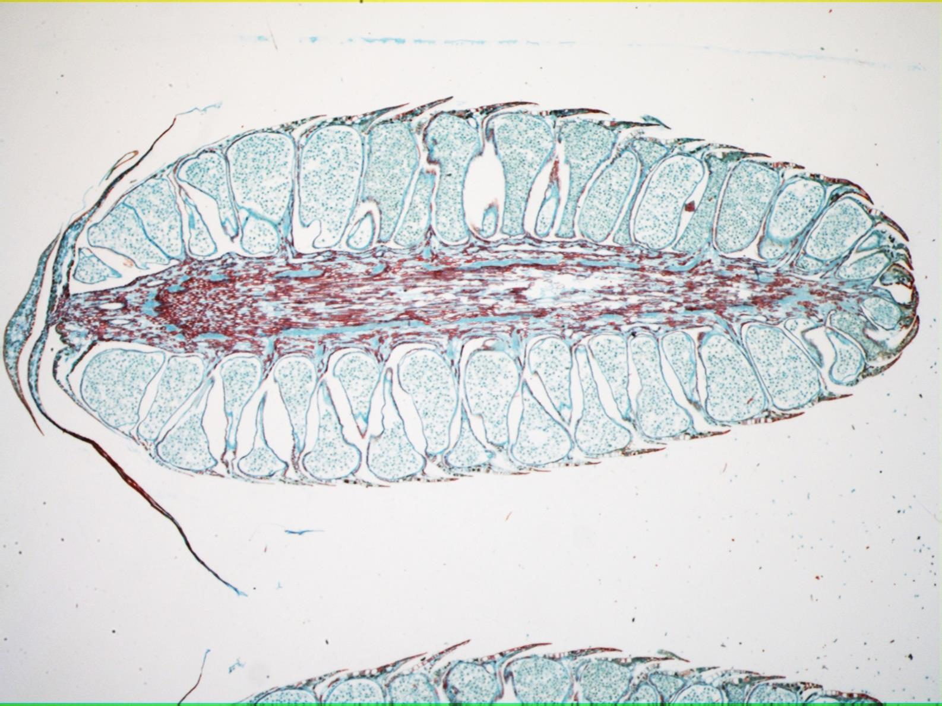
Pollen Cone Longitudinal Section

Slide 5
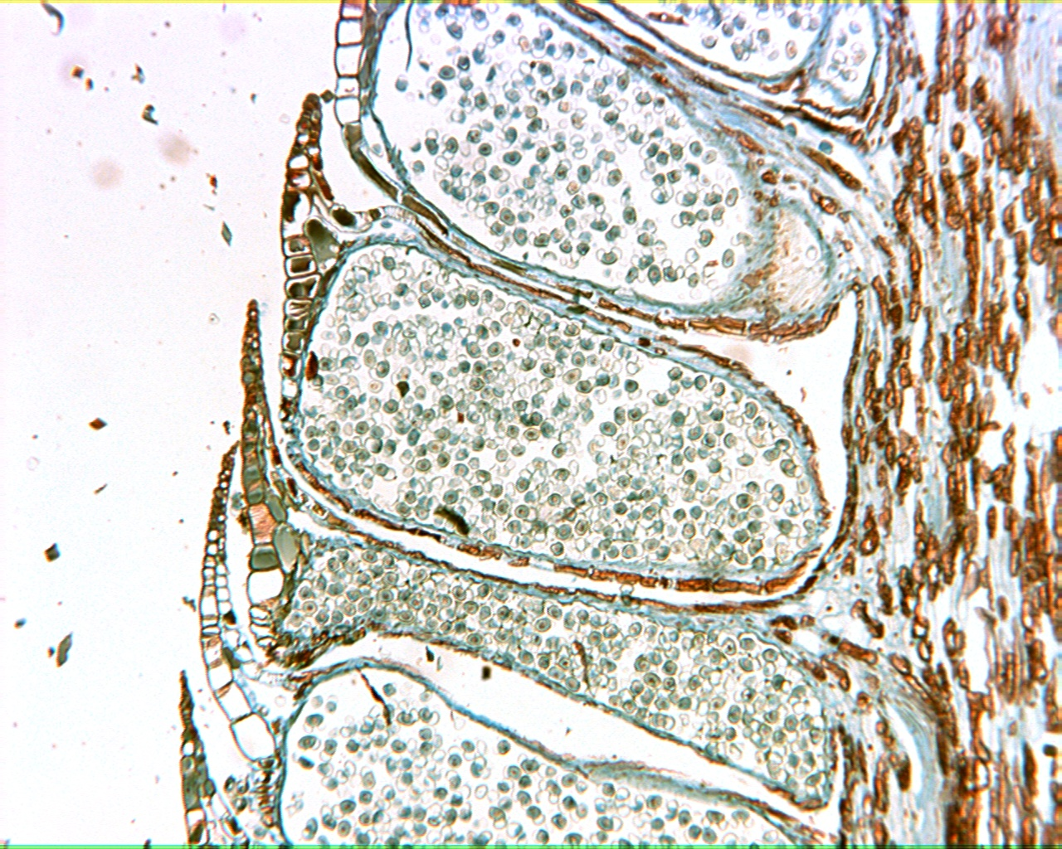
Pollen Cone 100X

Slide 6
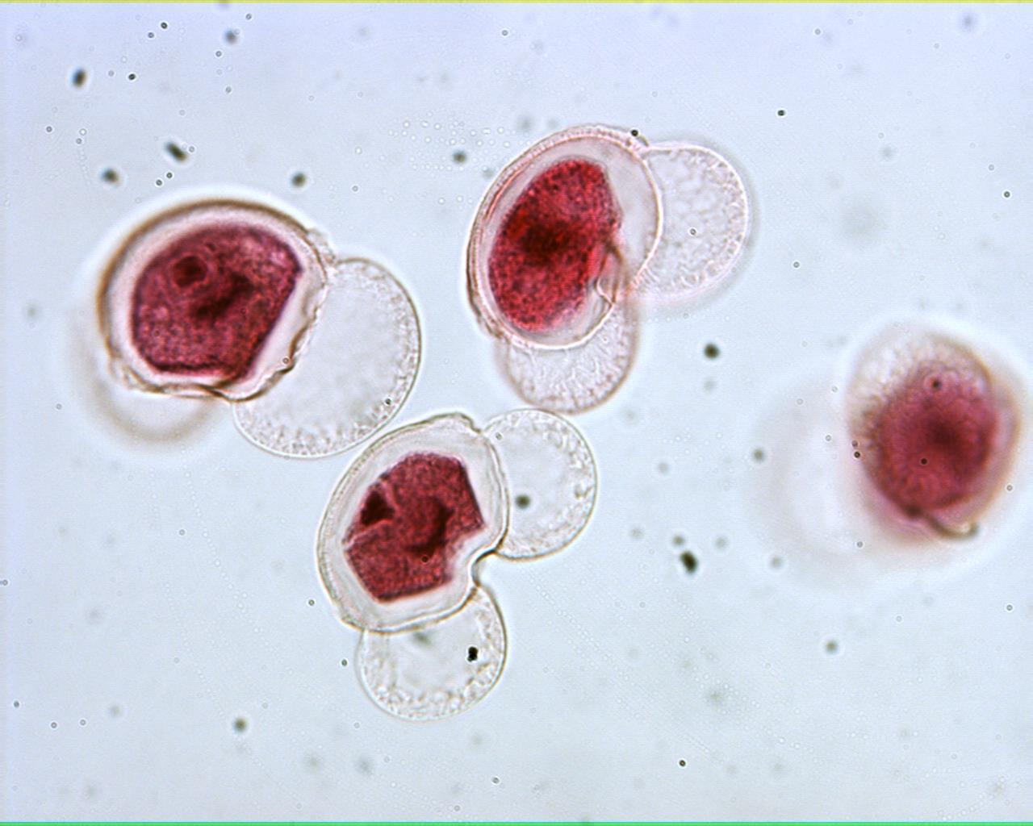
Pine Pollen 400X

Slide 7
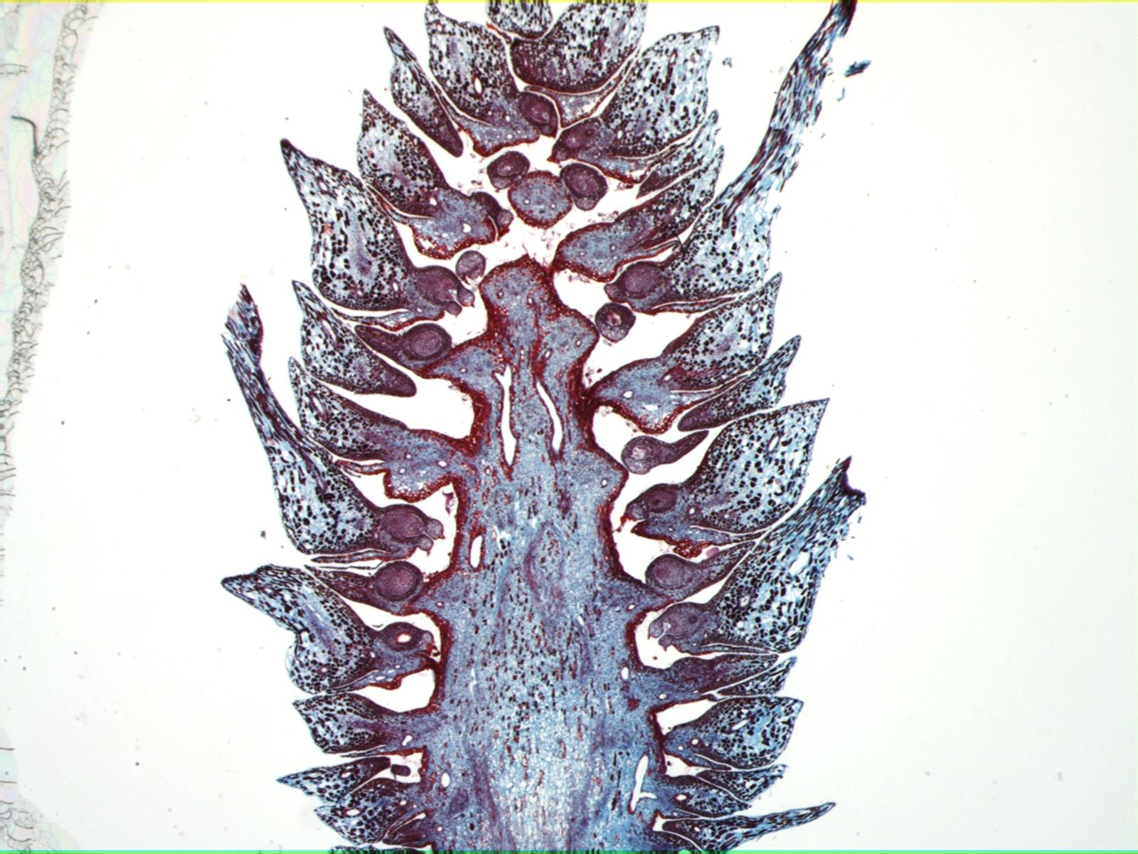
Pine Ovulate Cone Longitudinal Section

Slide 8
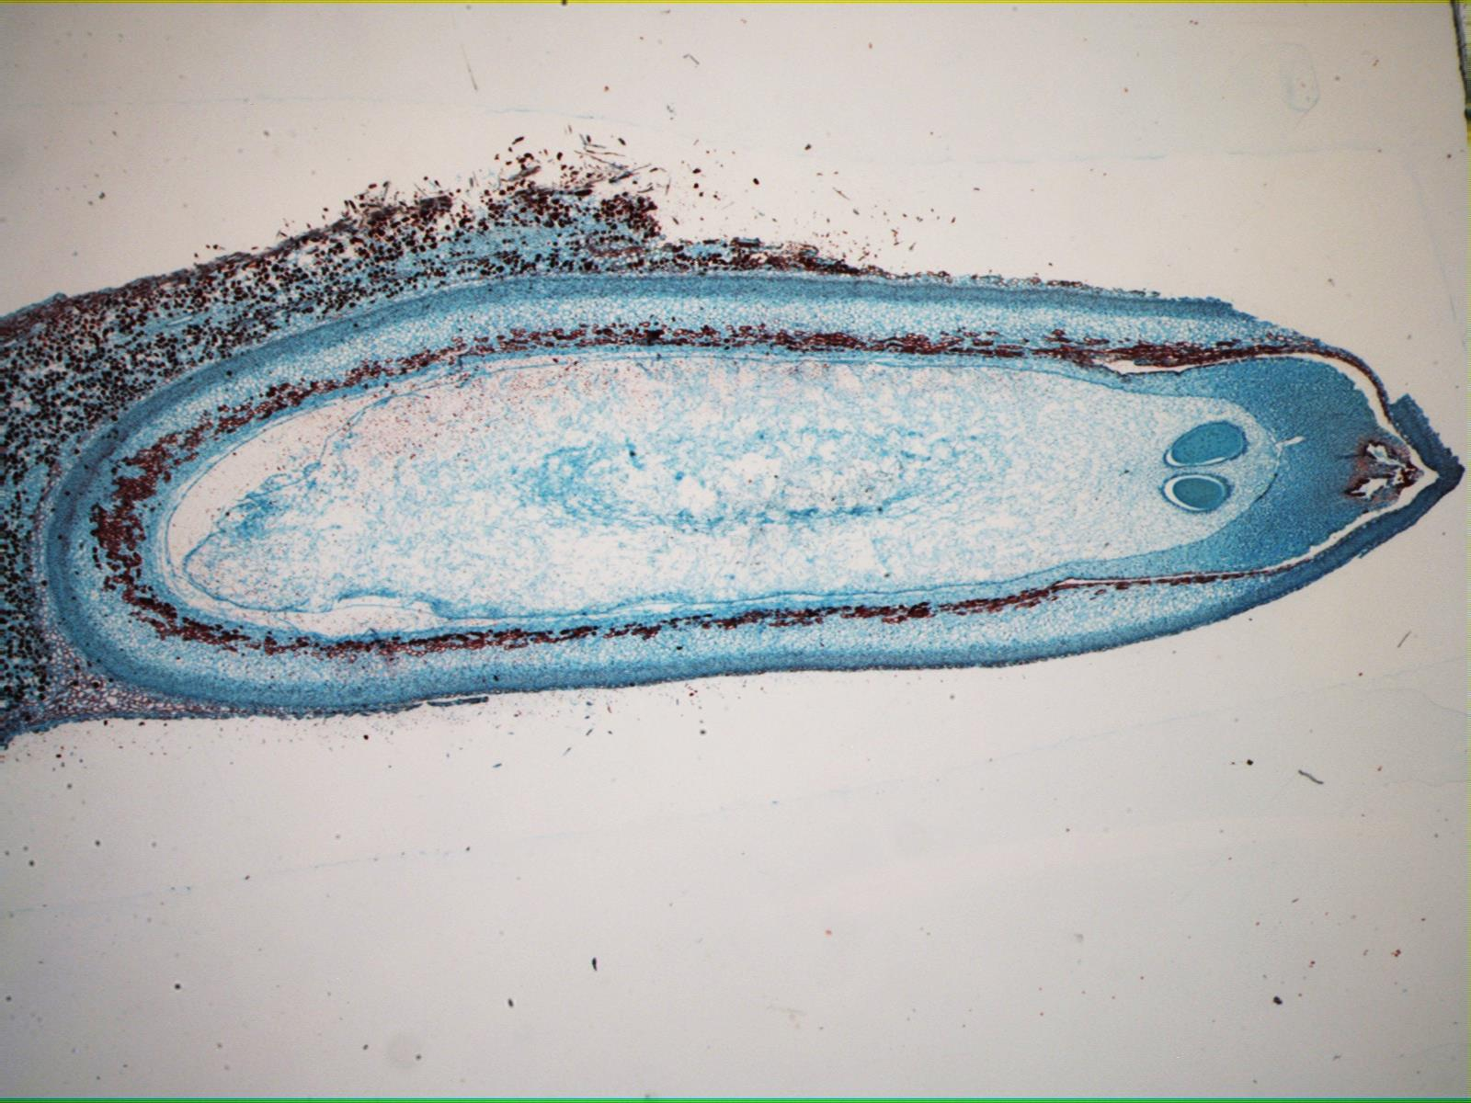
Pine Ovule 20X

Slide 9
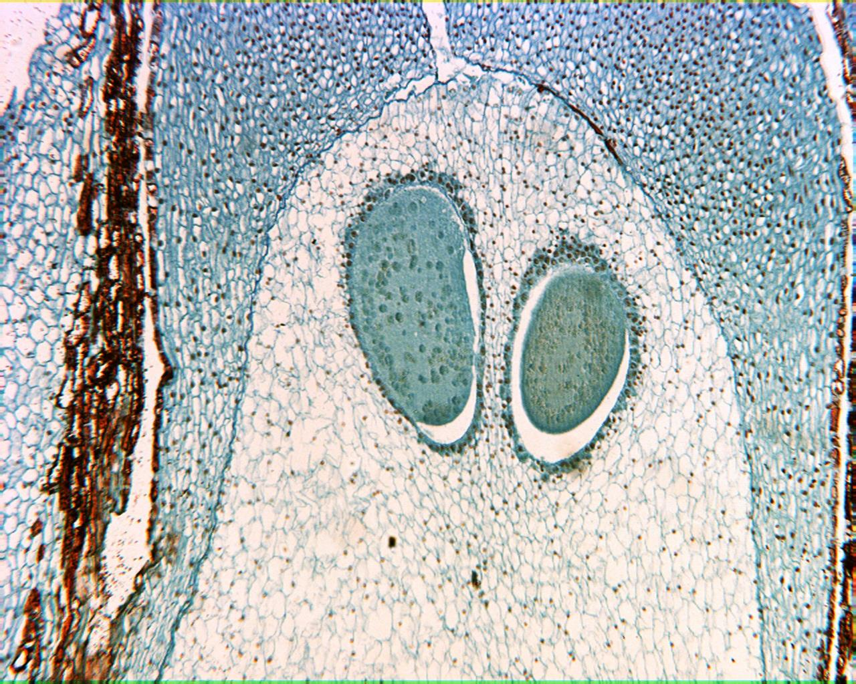
Pine Ovule 40X

Slide 10
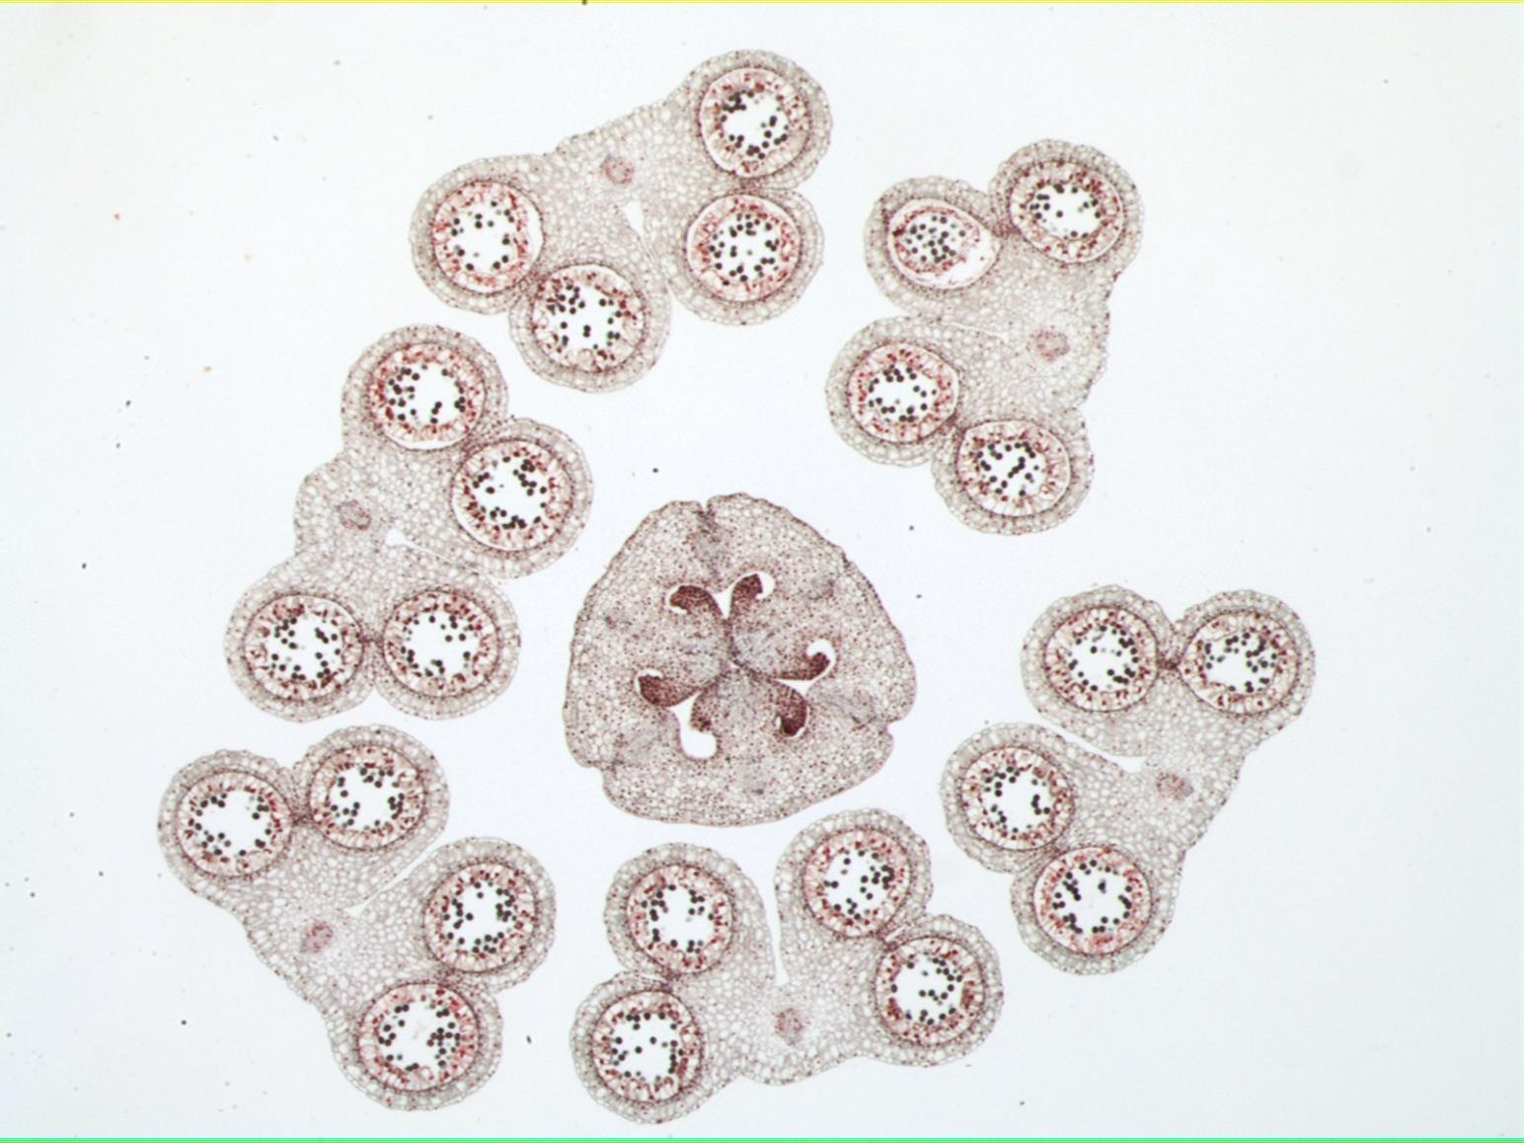
Lily Flower Cross Section

Slide 11
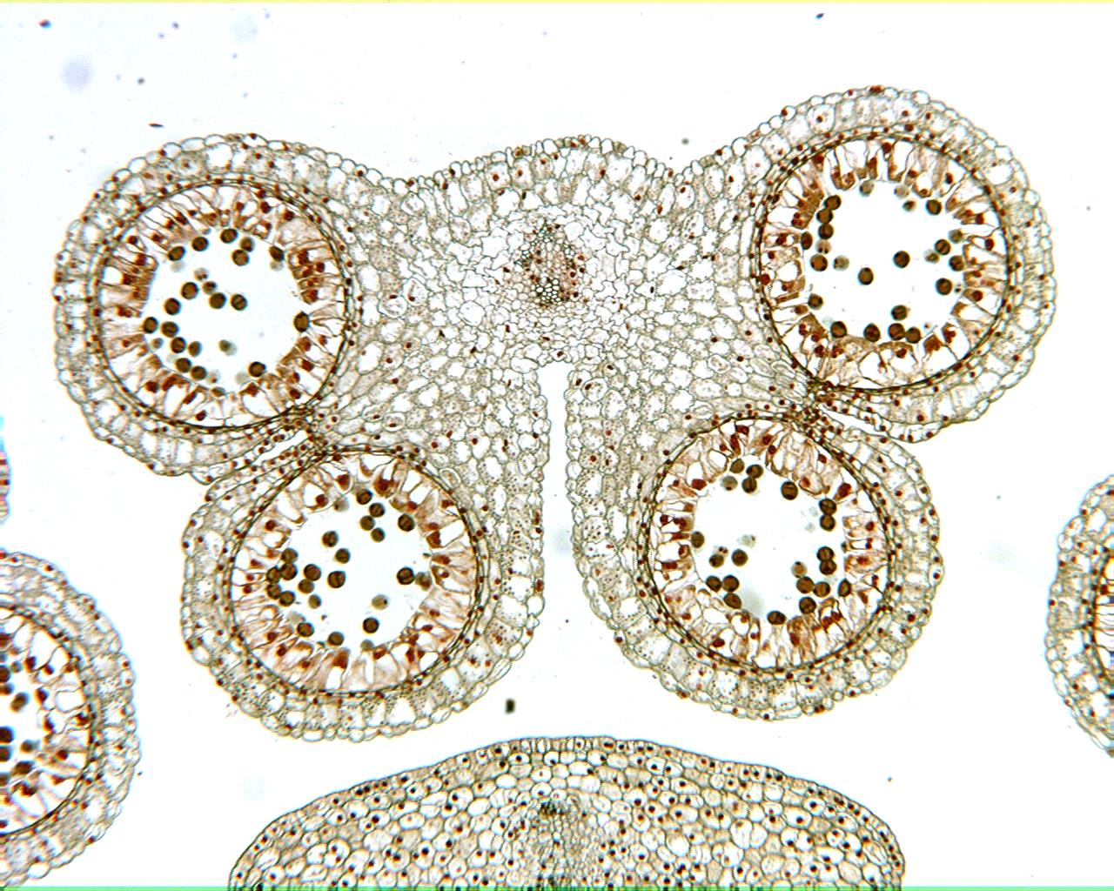
Lily Anther 40X

Slide 12
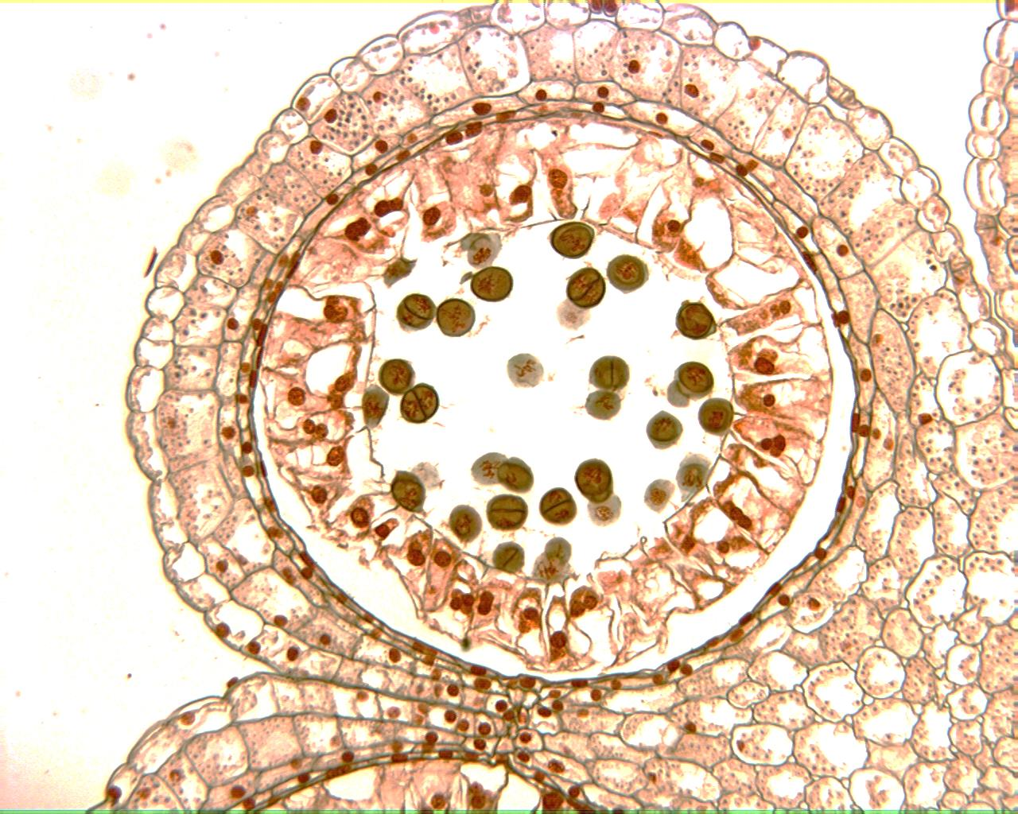
Lily Anther 100X

